Slide 1
YAP and YDAWG Data Analytics Case Study Preparation
R Workshop

Slide 2
Introduction
Why R for data analytics?
Used by many companies
Purpose built for statistics
Great editor (R studio)
Free packages for data, visualisation and machine learning

Slide 3
Goals
In this session you’ll learn about:
Transforming Data
Exploring data with visualisations
Machine learning
Model visualisations
Focus on machine learning with the first two sections to get us there.

Slide 4
Installation and Troubleshooting
Follow installation instructions for Windows or Mac
Download this code from the github link https://github.com/ActuariesInstitute/YAP-YDAWG-R-Workshop
Or run in the web browser! http://mybinder.org/v2/gh/ActuariesInstitute/YAP-YDAWG-R-Workshop/master?urlpath=rstudio

Slide 5
Credits
YAP and YDAWG R Workshop team - Contributions from:
Jonathan Shen
Tim Lam
Josh Jaroudy
Cindy Vuong
Arjun Sathasivam
Heloísa Bete
Michelle Ng
Jacky Poon

Slide 6
TransformING DATA
YAP and YDAWG Data Analytics Case Study Preparation
R Workshop

Slide 7
DATA SLIDES GO HERE

Slide 8
Transforming Data for Models Rationale
Data is often categorical.
However underlying ML models often matrix calculations on numerical data
Some R packages have logic to transform categorical variables to numeric automatically, but others do not.
So it is often good practice to convert factor variables to numeric data before modelling.

Slide 9
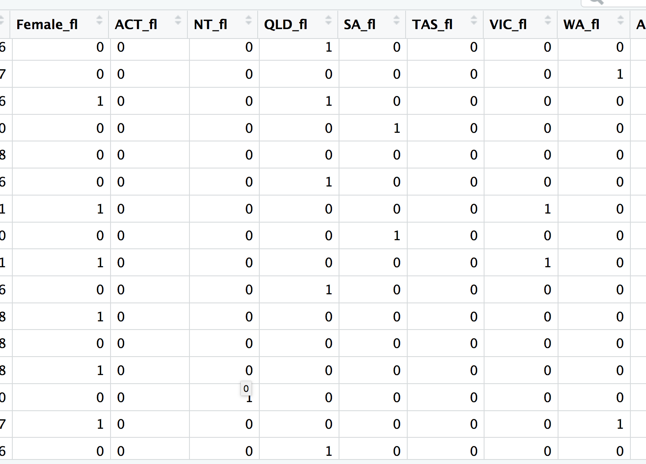
Transforming Data for Models Categorical Variables
In our example, we can set flags manually for gender and each state:
Setting one/zero flags is called “one-hot encoding” and is a type of “contrast”.

Slide 10
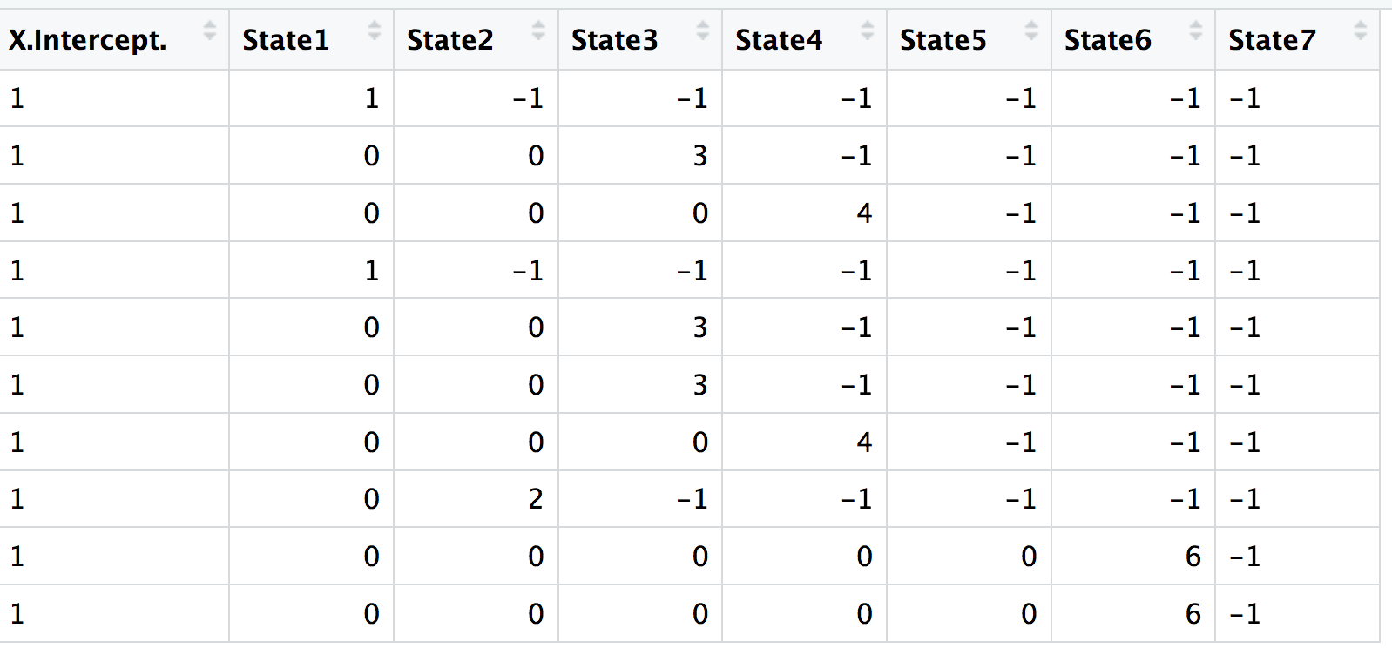
Transforming Data for Models Categorical Variables
Or use model.matrix to set a “contrast” automatically:

Slide 11
Transforming Data for Models Categorical Variables
Common transformations used for various model types and purposes
Transformation | How | Application Considerations
One-Hot Encoding | New variables that is e.g. 1 or 0 for each category [except for the first one] | Works for most models Most transparent option But memory intensive
Integer Encoding | Number categories from 1,2,…n | Moderate memory usage Do NOT use for linear models! Neural Network using embedding layer
Mean Encoding | Take the average of the response for each category and use that as the representation of the category | May be better than integer for some models – e.g. likely to split better for decision trees
Binary / Hash Encoding | Binary e.g. three 1/0 columns can represent 8 levels (2^3) Category no. 5 = 1 | 0 | 1 | Limits memory usage Potentially loses information

Slide 12
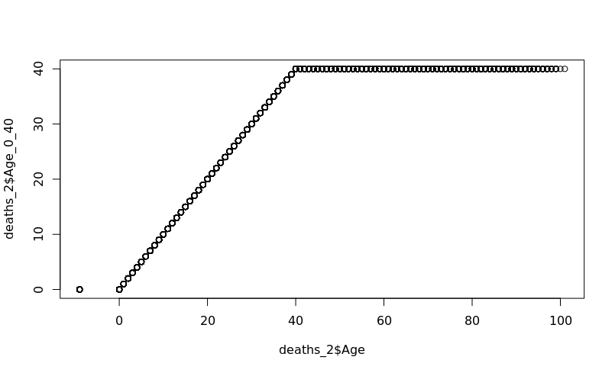
Transforming Data for Models Continuous Variables
Cap Age at a certain level using pmin and pmax:

Slide 13
Transforming Data for Models Continuous Variables
Common transformations used for various model types:
Model | Transformations
[Generalised] Linear Models | Splines Legendre Polynomials
Decision Trees, Random Forests and Boosting | Generally not needed except missing (see below)
Neural Networks | Standardise to range or mean/variance
Treatment of missing data (generally) | Impute with mean value Train another model to predict and fill missing data Missing flag

Slide 14
Further learning - Data
Dplyr
Query data frames and SQL databases with similar syntax
Part of the “tidyverse” of packages including next section’s “ggplot2” (https://www.tidyverse.org/ )
Data.table
Fast data manipulation

Slide 15
EXPLORATORY Visualisation
YAP and YDAWG Data Analytics Case Study Preparation
R Workshop

Slide 16
Basic Visualisation
There are a number of basic visualisation functions available in base R e.g. plot(), hist(), barplot()
These are fine for “quick and dirty” graphs when you’re doing exploratory analysis.
It’s possible to make these look good, but can be a lot of effort!

Slide 17
Visualisation using ggplot2
Based on the ‘grammar of graphics’: specify the dataset, the variable to plot (+ its characteristics) and the type of graph.
Sample barchart: ggplot(data=X, aes(var)) + geom_bar()
e.g. Plotting the ‘Speed.Limit’ variable on the ‘deaths’ dataset: ggplot(data=deaths, aes(deaths$Speed.Limit)) + geom_bar()
Similarly, you can try geom_line() and geom_histogram()

Slide 18
Other Characteristics
Incrementally build up graphs e.g. histogram characteristics, labels and titles, axis limits
ggplot(data=deaths, aes(deaths$claim_severity)) +
geom_histogram(breaks = c(seq(0, 9000000, 250000)), col="white", fill = "black")+
labs(title="Claim Severity Distribution", x="Claim Severity",y="Count")+
xlim(c(0, 10000000)) + ylim(c(0, 10000))

Slide 19
Summary Stats
Simple summary statistics can be directly calculated
e.g. average claim_severity by age
ggplot(data=deaths, aes(x=factor(Age), y=claim_severity)) + stat_summary(fun.y=“mean”, geom=“bar”)

Slide 20
Further learning – Exploratory Vis
Graphing with base R: https://www.statmethods.net/graphs/index.html
ggplot2 homepage: https://ggplot2.tidyverse.org/
Graphing with ggplot2: http://www.cookbook-r.com/Graphs/

Slide 21
Machine Learning
YAP and YDAWG Data Analytics Case Study Preparation
R Workshop

Slide 22
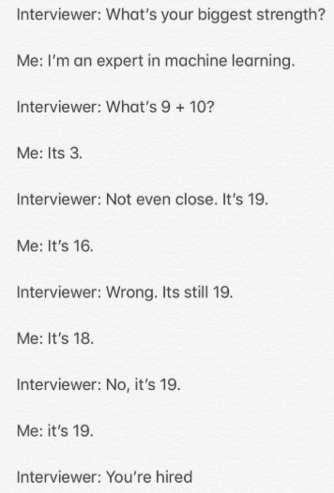
What is Machine Learning?
Deals with the problem of extracting features from data to make predictions:
Forecasting (e.g. sales, demand for insurance products)
Classifying (e.g. credit risk assessment)
Detecting anomalies (e.g. cases of insurance fraud)
Find patterns that generalise beyond the data, and which can be used to predict outcomes for new data you haven’t seen.
Machine learning models are built using the training data
Their suitability is tested against the validation data

Slide 23
Pre-processing the data
Have a clear understanding of:
Data
Clean data for missing values; deal with outliers
Data types (e.g. Are the inputs labelled or unlabelled)
Feature Engineering – Process of going from raw data to ready to model data
Visualise data
Constraints
Data storage
Do the predictions have to be fast – E.g. In autonomous driving, classifying road signs quickly is important
Does learning have to be fast – Is it necessary to train models quickly

Slide 24
Machine Learning Model Considerations
Does the model meet the business goals
How explainable is the model
Accuracy of the model
How fast is it to build and make predictions with the model
Scalability of the model

Slide 25
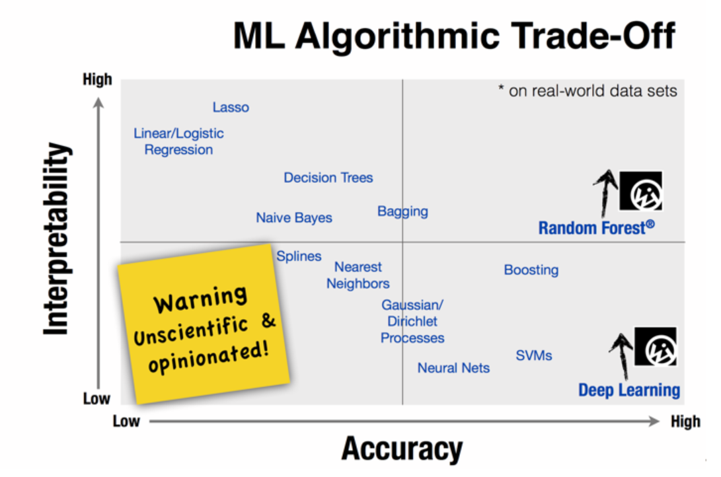
Source: Choosing the right machine learning algorithm,
https://hackernoon.com/choosing-the-right-machine-learning-algorithm-68126944ce1f

Slide 26
Algorithms Covered
Linear Regression
K-Means Clustering
Random Forest

Slide 27
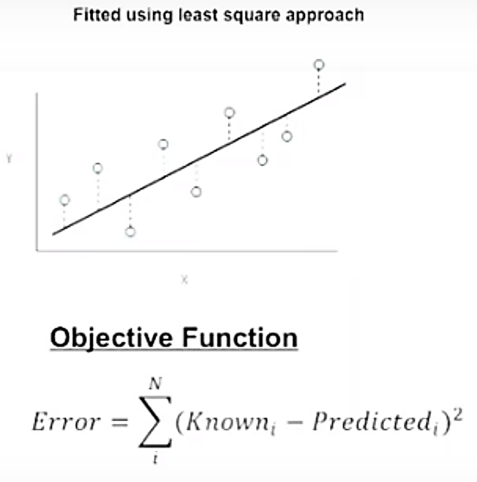
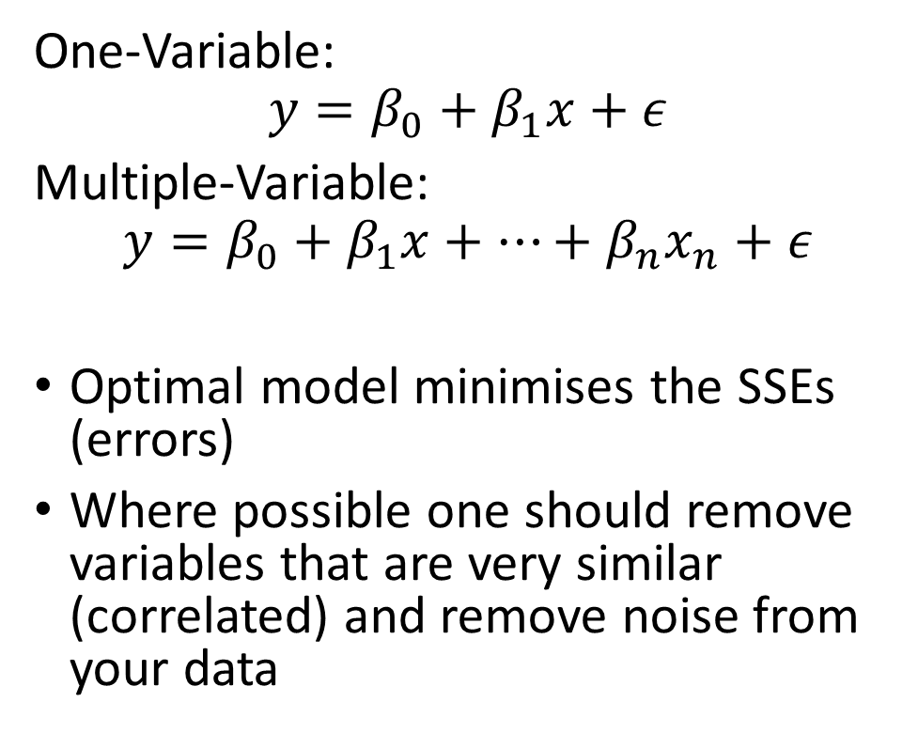
Linear Regression
One-Variable:
Multiple-Variable:
Optimal model minimises the SSEs (errors)
Where possible one should remove variables that are very similar (correlated) and remove noise from your data

Slide 28
Linear Regression
Advantages
Fast, simple and widely used
Disadvantages
Assumes a linear relationship
Uses
Good first algorithm to try to gain insights into the relationship between the response variable (Y) and predictor variables (X)
Results are interpretable
Assumes independence within the dataset
Sensitive to outliers
Focuses on the relationship between the mean of the dependent variable and the independent variables. The mean is not a complete description (e.g. if you want to focus on the extremes).

Slide 29
Linear Regression – R Exercise
It’s time for the exercise. Here’s some code to get your started:
model <- lm(Y ~ X1 + X2 + …, data=mydata)
Other useful functions:
summary(model) - Results on the beta coefficients, r-squared and residuals
coefficients(model) - Model coefficients
cofint(model, level = 0.95) - Confidence intervals for model parameters
fitted(model) - Predicted values
residuals(model) - Residuals
anova(model) – Anova table
influence(model) – Regression diagnostics

Slide 30
K-Means Clustering
Unsupervised method (when you have unlabelled data) used to find groups within the data. Partition n observations into a fixed number of k clusters.
Grouping is based on distance between points.
1. Specify the desired number of clusters
2. Randomly assign each point to a cluster
3. Compute the cluster centroids
4. Reclassify each point to the nearest centroid
5. Recompute cluster centroids
6. Repeat steps 4 and 5 until there is no further improvement

Slide 31
K-Means Clustering

Slide 32
K Means Clustering
Advantages
Easy to implement
Disadvantages
Choice of centres requires judgement and is subjective
Example Uses
Customer Segmentation – Targeted marketing
Initial seeds has a strong impact on final results
Sensitive to scale: Rescaling your dataset (normalisation) can change results
Insurance Fraud Detection – Using past data on fraudulent claims, it’s possible to isolate potential new fraudulent claims based on proximity to clusters with fraudulent patterns

Slide 33
K Means Clustering – R Exercise
It’s time for the exercise. Here’s some code to get your started:
kmeans(x, centres = c, nstart = n) where
x - Data
centres - Pre-defined number of clusters
nstart – Model attempts n initial configurations
E.g. N = 25 generates 25 initial random centroids. The optimal configuration will be chosen for the algorithm.

Slide 34
Issue 1: Model Selection
Note that due to the random initialisation, one can obtain different clustering results.
When k-means is run multiple times, the model that generates the smallest total within cluster sum of squares (SS)* is selected (i.e. a local minimum). There’s no guarantee to obtain a global minimum.
*SS - For each observation, determine the squared euclidean distance from observation to centre of cluster and sum all the distances.

Slide 35
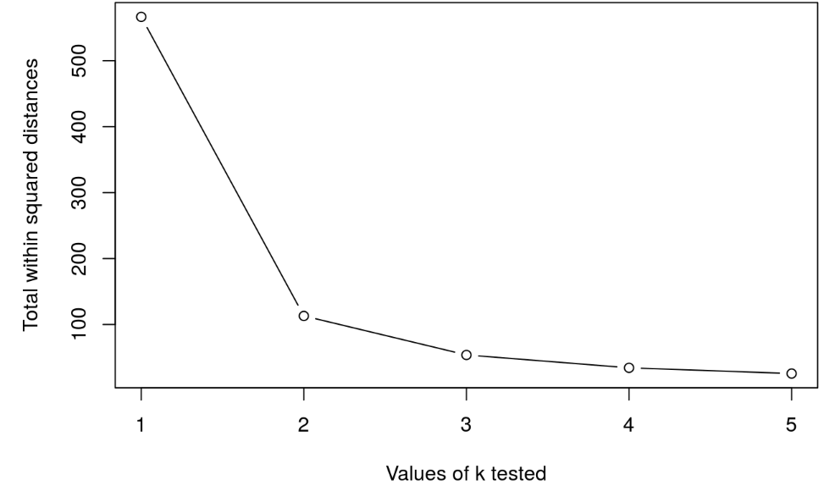
Issue 2: Cluster Selection
Run k-means with k=1, k=2, …, k=n
Record total within SS for each value of k.
Choose k at the elbow position, as illustrated below. Balance between over fitting and accuracy.

Slide 36
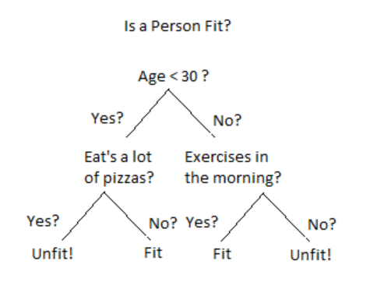
Decision Tree
Uses a branching method to illustrate possible outcomes of a decision
Decision trees are a good choice when you have a large number of variables and aren’t sure which ones are key or how they relate. The decision at the top of the model is the variable that most affects the outcome.
Each node represents an input variable (x) and a split point on that variable
The leaf nodes of the tree contain an output variable (y) which is used to make a prediction.

Slide 37
Random Forest
Are an ensemble of decision trees
Multiple samples of your training data are taken and decision trees are constructed for each data sample. Each model makes a prediction with the new data and the predictions are averaged to give a better estimate of the true output
E.g. Suppose you want to watch a movie but are uncertain of its reviews. You ask 10 people and 7 say that the movie was bad. Since the majority didn’t like the movie, you decide against watching it.
Note that decision trees are created so that rather than selecting optimal split points, suboptimal splits are made by introducing randomness
The models created for each sample of the data are therefore more different than they otherwise would be, but still accurate in their unique and different ways. Combining their predictions results in a better estimate of the true underlying output value

Slide 38
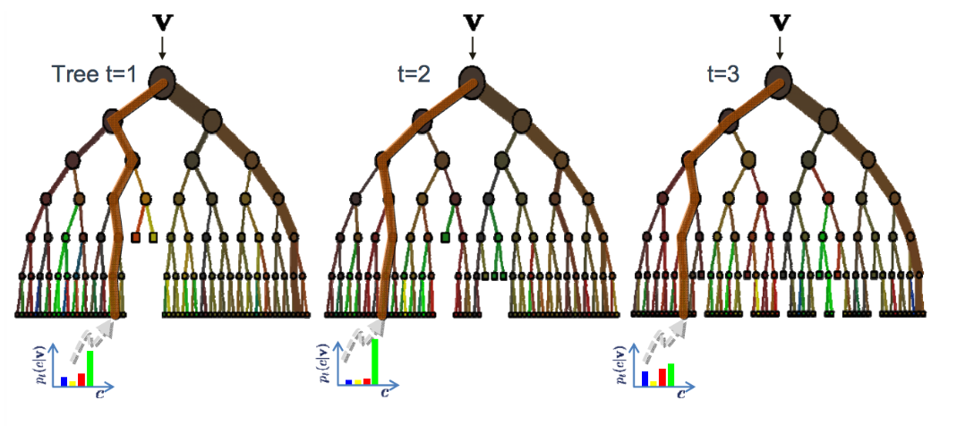
Random Forest

Slide 39
Random Forest
Advantages
Are non-parametric; have no distribution assumptions
Disadvantages
Less interpretable and less easier to explain than regression/clustering
Uses
Can be used to help identify significant variables from thousands of inputs using its variable importance plot
Reliable and can handle non-linearity in the dataset
Robust against outliers in the predictive variables
Many parameters to adjust such as the number of trees and the tree depth although default parameters may work
Does not tend to overfit especially when cross validation is incorporated
Highly scalable to any number of dimensions and has generally acceptable performance
Not possible to iteratively improve the generated model
Performance may be slow
Robust to correlated parameters

Slide 40
Random Forest – R Exercise
It’s time for the exercise. Here’s some code to get your started:
randomForest(Y ~ X1 + X2 + …, data, nodesize, ntree, mtry) where:
data - Training dataset
nodesize - The minimum number of observations in the terminal node. The higher the number, the lower the tree depth.
ntree - Number of decision trees to simulate. The larger, the more operationally intensive the algorithm becomes.
mtry – Number of variables randomly sampled at each split.

Slide 41
Further Learning – ML
A Tour of The Top 10 Algorithms for Machine Learning Newbies, https://towardsdatascience.com/a-tour-of-the-top-10-algorithms-for-machine-learning-newbies-dde4edffae11
Introduction to Machine Learning with R - https://lgatto.github.io/IntroMachineLearningWithR/index.html
Gradient Boosting – Catboost, XGBoost or LightGBM – e.g. Minh Phan’s WOMD video: https://www.youtube.com/watch?v=G-HQ9HLV8HY
Neural Networks – Jacky Poon’s Analytics Snippet https://www.actuaries.digital/2018/08/23/analytics-snippet-multitasking-risk-pricing-using-deep-learning/

Slide 42
MODEL VISUALISATION
YAP and YDAWG Data Analytics Case Study Preparation
R Workshop

Slide 43
DALEX – Model Interpretation
We define an ‘explainer’ which contains information about the machine learning model we have built
expl <- explain(model, data, y)
model – a model object
data – the dataset we built the model with
y – the target variable
In more complex cases, you will also need to specify a function to generate predictions and the link function

Slide 44
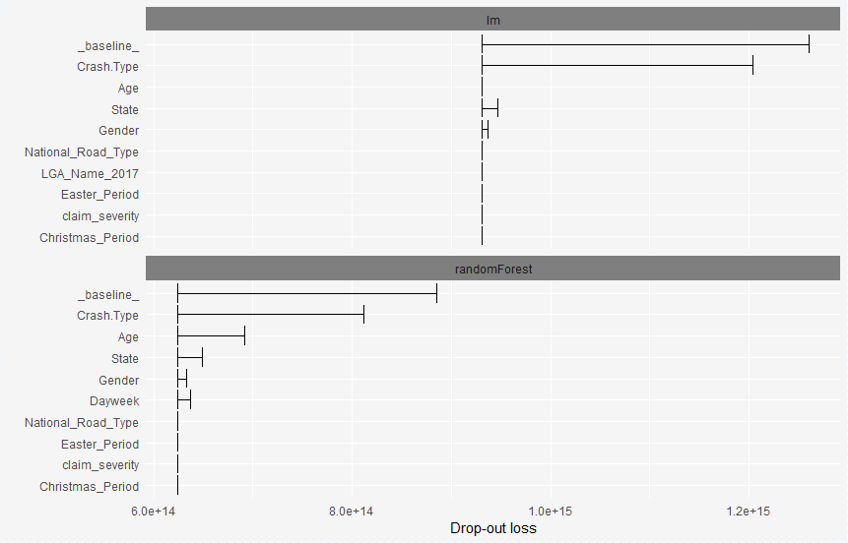
DALEX – Variable Importance
Identifies the variables which contribute most to model predictions
vi1 <- variable_importance(explainer1)
vi2 <- variable_importance(explainer2)
plot(vi1, vi2)
E.g. in both models, Crash.Type is the most important feature

Slide 45
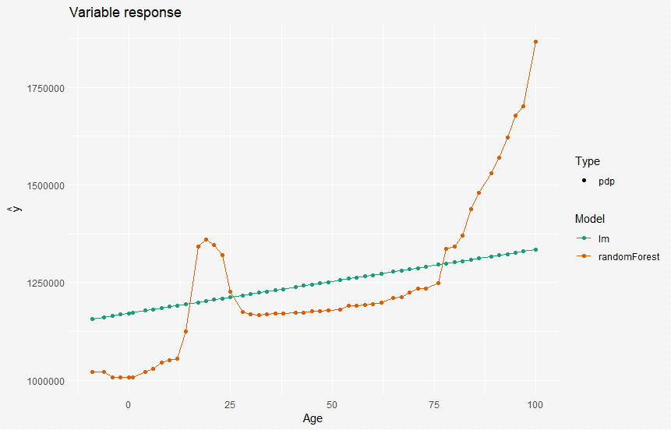
DALEX – Partial Dependence Plot
Plots the relationship between the target and variable of interest, as inferred from the model structure
E.g. the randomForest has fitted a more complex age curve
pd1 <- variable_response(explainer1, “age”, “pdp”)

Slide 46
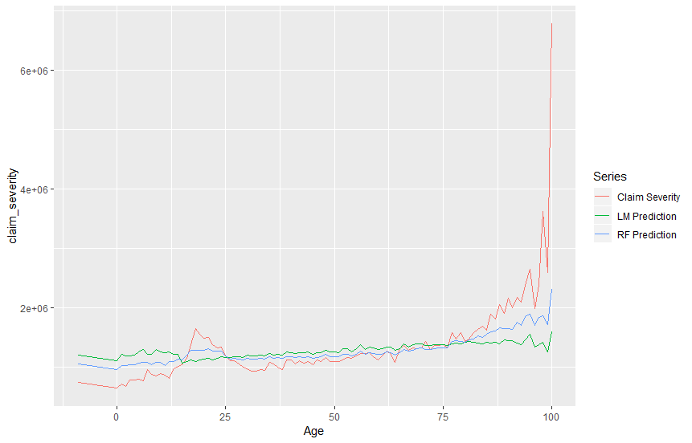
Actual vs Model Predictions
Plots the target variable vs the model predictions
Both models need some work.
The RF appears to be a slightly better fit.
age_avg <- aggregate(deaths_m[, c("claim_severity", "lm_pred", "rf_pred")], list(Age = deaths_m$Age), mean)
age_avg_long <- melt(age_avg, id="Age")
ggplot(data=age_avg_long, aes(x=Age, y=value, colour=variable)) + geom_line()

Slide 47
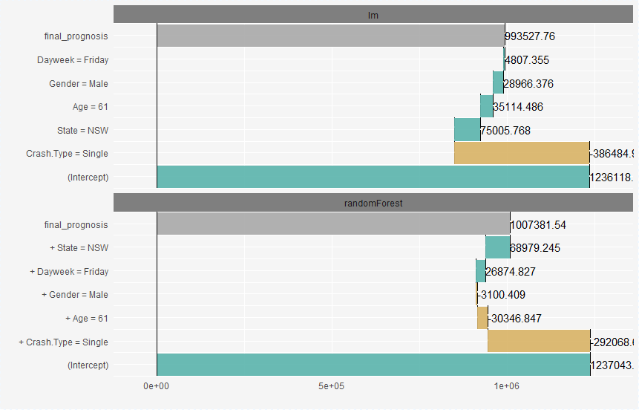
DALEX: Explain individual predictions
Indicates the contribution of each variable to the model prediction
pb1 <- prediction_breakdown(explainer1, row1)

Slide 48
Further Learning – Model Vis
DALEX Documentation: https://www.rdocumentation.org/packages/DALEX/versions/0.2.4
Josh Jaroudy’s presentation from the 2018 DA Seminar: https://actuaries.logicaldoc.cloud/download-ticket?ticketId=88dc3a68-095f-4b4c-90a2-b308fa487146

Slide 49
Advanced Visualisation
YAP and YDAWG Data Analytics Case Study Preparation
R Workshop

Slide 50
Further learning
Advanced visualisation (in the pack)
Learn about literate programming and R notebooks
Create an interactive dashboard using flexdashboard and R Shiny

Slide 51
THANK YOU
YAP and YDAWG Data Analytics Case Study Preparation
R Workshop

